Slide 1
United Nations Convention on the Rights of the Child,1989
Dr. Apeksha Chaudhary
Assistant Professor, Institute of Legal Studies
Chaudhary Charan Singh University, Meerut . Apeksha Chaudhary
Assistant Professor, Institute of Legal Studies
Chaudhary Charan Singh University, Meerut

Slide 2
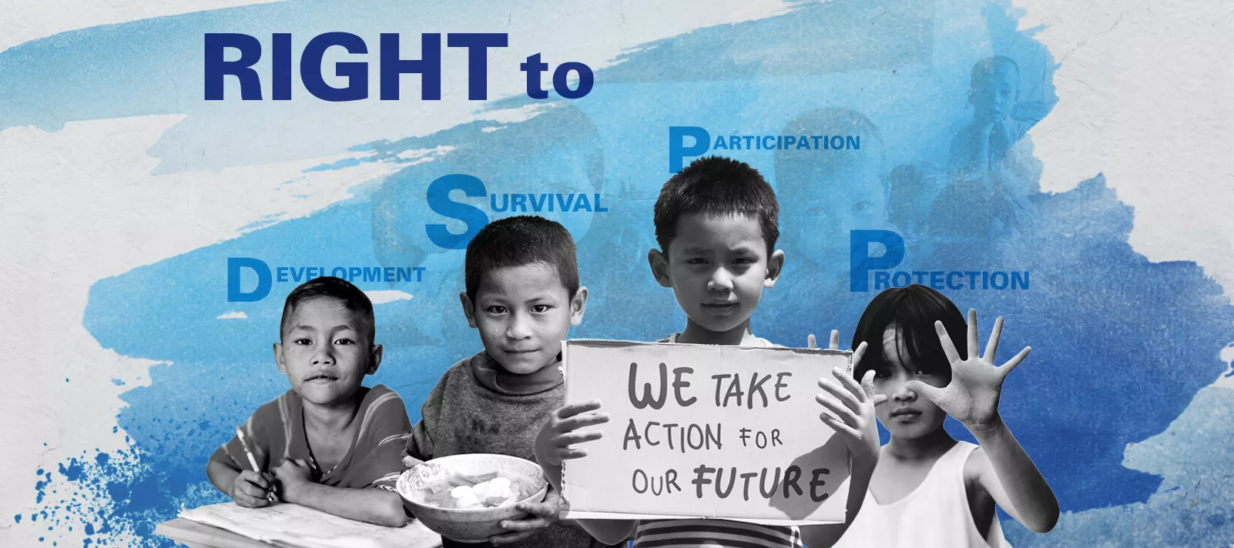
All children have rights and those rights must be protected.”

Slide 3
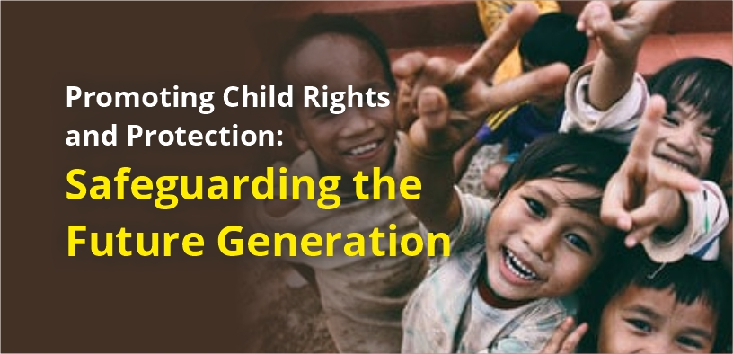
Who is child?

Slide 4
Background & History
The United Nations Convention on the Rights of the Child (UNCRC) represents a milestone in international human rights law, fundamentally shifting the global legal paradigm by formally recognizing children as individual rights-holders rather than mere property of their parents or passive objects of care.
The historical foundation of this near-universal legal framework was deeply influenced by early twentieth-century child rights advocacy notably the Geneva Declaration of the Rights of the Child, 1924.
Building upon decades of foundational advocacy, the UNCRC was formally adopted by the UN General Assembly on November 20, 1989. It officially entered into force shortly after, on September 2, 1990
Since its inception, it has achieved an unprecedented level of global consensus, becoming the most widely ratified human rights treaty in history. Currently, 196 countries are party to the convention, binding them to international standards that protect the civil, political, economic, social, and cultural rights of all human beings under the age of eighteen.

Slide 5

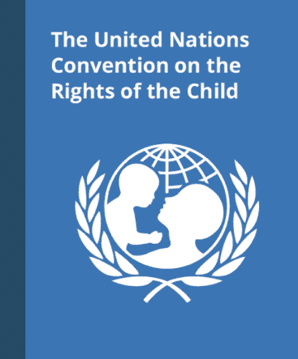
Core Objective
The primary objective of the UNCRC is to establish comprehensive, legally binding international standards that protect the civil, political, economic, social, and cultural rights of all human beings under the age of 18.
The United Nations Convention on the Rights of the Child is guided by four core principles that shape all child rights policies and actions in India:
Non-Discrimination : Every child, regardless of gender, caste, religion, disability or socio-economic background, has equal rights. Laws and schemes must ensure that no child is excluded from education, healthcare or protection.
Best Interests of the Child : All decisions affecting children, whether taken by courts, institutions or policymakers, must prioritise their overall well-being and long-term development.
Right to Survival and Development : Children have the right to nutrition, healthcare, education and a safe environment that enables them to grow physically, mentally and emotionally.
Right to Participation : Children have the right to express their views in matters affecting them and to be heard in age-appropriate and meaningful ways

Slide 6
Guiding Principles
Article
Article 1 | (Definition of the child) Everyone under the age of 18 has all the rights in the Convention.
Article 2 | (Non-discrimination)The Convention applies to every child without discrimination, whatever their ethnicity, sex, religion, language, abilities or any other status, whatever they think or say, whatever their family background
Article 3 | (Best interests of the child) The best interests of the child must be a top priority in all decisions and actions that affect children.
Article 4 | (Implementation of the Convention) - Governments must do all they can to make sure every child can enjoy their rights by creating systems and passing laws that promote and protect children’s rights.
Article 5 Article 6 | (Parental guidance and a child’s evolving capacities) -Governments must respect the rights and responsibilities of parents and carers to provide guidance and direction to their child as they grow up, so that they fully enjoy their rights. This must be done in a way that recognises the child’s increasing capacity to make their own choices. (Life, survival and development)- Every child has the right to life. Governments must do all they can to ensure that children survive and develop to their full potential

Slide 7
Guiding Principles
Article
Article 7 Article 8 | (Birth registration, name, nationality, care) - Every child has the right to be registered at birth, to have a name and nationality, and, as far as possible, to know and be cared for by their parents. (Protection and preservation of identity)- Every child has the right to an identity. Governments must respect and protect that right, and prevent the child’s name, nationality or family relationships from being changed unlawfully
Article 9 | (Separation from parents) - Children must not be separated from their parents against their will unless it is in their best interests (for example, if a parent is hurting or neglecting a child). Children whose parents have separated have the right to stay in contact with both parents, unless this could cause them harm.
Article 10 Article 11 Article 12 | (Family reunification) - Governments must respond quickly and sympathetically if a child or their parents apply to live together in the same country. If a child’s parents live apart in different countries, the child has the right to visit and keep in contact with both of them. (Abduction and non-return of children) - Governments must do everything they can to stop children being taken out of their own country illegally by their parents or other relatives, or being prevented from returning home. (Respect for the views of the child) - Every child has the right to express their views, feelings and wishes in all matters affecting them, and to have their views considered and taken seriously. This right applies at all times, for example during immigration proceedings, housing decisions or the child’s day-to-day home life..
Article 13 | (Freedom of expression) - Every child must be free to express their thoughts and opinions and to access all kinds of information, as long as it is within the law.

Slide 8
Guiding Principles
Article
Article 14 | (Freedom of thought, belief and religion) - Every child has the right to think and believe what they choose and also to practise their religion, as long as they are not stopping other people from enjoying their rights. Governments must respect the rights and responsibilities of parents to guide their child as they grow up..
Article 15 | (Freedom of association) - Every child has the right to meet with other children and to join groups and organisations, as long as this does not stop other people from enjoying their rights.
Article 16 | (Right to privacy) -Every child has the right to privacy. The law should protect the child’s private, family and home life, including protecting children from unlawful attacks that harm their reputation
Article 17 | (Access to information from the media) - Every child has the right to reliable information from a variety of sources, and governments should encourage the media to provide information that children can understand. Governments must help protect children from materials that could harm them
Article 18 | (Parental responsibilities and state assistance) - Both parents share responsibility for bringing up their child and should always consider what is best for the child. Governments must support parents by creating support services for children and giving parents the help they need to raise their children.

Slide 9
Guiding Principles
Article
Article 19 | (Protection from violence, abuse and neglect) - Governments must do all they can to ensure that children are protected from all forms of violence, abuse, neglect and bad treatment by their parents or anyone else who looks after them.
Article 20 | (Children unable to live with their family) - If a child cannot be looked after by their immediate family, the government must give them special protection and assistance. This includes making sure the child is provided with alternative care that is continuous and respects the child’s culture, language and religion
Article 21 | (Adoption) -Governments must oversee the process of adoption to make sure it is safe, lawful and that it prioritises children’s best interests. Children should only be adopted outside of their country if they cannot be placed with a family in their own country
Article 22 | (Refugee children) - If a child is seeking refuge or has refugee status, governments must provide them with appropriate protection and assistance to help them enjoy all the rights in the Convention. Governments must help refugee children who are separated from their parents to be reunited with them.
Article 23 | (Children with a disability) - A child with a disability has the right to live a full and decent life with dignity and, as far as possible, independence and to play an active part in the community. Governments must do all they can to support disabled children and their families.

Slide 10
Guiding Principles
Article
Article 24 | (Health and health services) - Every child has the right to the best possible health. Governments must provide good quality health care, clean water, nutritious food, and a clean environment and education on health and well-being so that children can stay healthy. Richer countries must help poorer countries achieve this
Article 25 | (Review of treatment in care) - If a child has been placed away from home for the purpose of care or protection (for example, with a foster family or in hospital), they have the right to a regular review of their treatment, the way they are cared for and their wider circumstances.
Article 26 | (Social security) - Every child has the right to benefit from social security. Governments must provide social security, including financial support and other benefits, to families in need of assistance.
Article 27 | (Adequate standard of living) - Every child has the right to a standard of living that is good enough to meet their physical and social needs and support their development. Governments must help families who cannot afford to provide this.
Article 28 | (Right to education) - Every child has the right to an education. Primary education must be free and different forms of secondary education must be available to every child. Discipline in schools must respect children’s dignity and their rights. Richer countries must help poorer countries achieve this.

Slide 11
Guiding Principles
Article
Article 29 | (Goals of education) - Education must develop every child’s personality, talents and abilities to the full. It must encourage the child’s respect for human rights, as well as respect for their parents, their own and other cultures, and the environment.
Article 30 | (Children from minority or indigenous groups) - Every child has the right to learn and use the language, customs and religion of their family, whether or not these are shared by the majority of the people in the country where they live.
Article 31 | (Leisure, play and culture) - Every child has the right to relax, play and take part in a wide range of cultural and artistic activities.
Article 32 | (Child labour) - Governments must protect children from economic exploitation and work that is dangerous or might harm their health, development or education. Governments must set a minimum age for children to work and ensure that work conditions are safe and appropriate.
Article 33 | (Drug abuse) - Governments must protect children from the illegal use of drugs and from being involved in the production or distribution of drugs.

Slide 12
Guiding Principles
Article
Article 34 | (Sexual exploitation) - Governments must protect children from all forms of sexual abuse and exploitation.
Article 35 | (Abduction, sale and trafficking) - Governments must protect children from being abducted, sold or moved illegally to a different place in or outside their country for the purpose of exploitation.
Article 36 | (Other forms of exploitation) - Governments must protect children from all other forms of exploitation, for example the exploitation of children for political activities, by the media or for medical research
Article 37 | (Inhumane treatment and detention) - Children must not be tortured, sentenced to the death penalty or suffer other cruel or degrading treatment or punishment. Children should be arrested, detained or imprisoned only as a last resort and for the shortest time possible. They must be treated with respect and care, and be able to keep in contact with their family. Children must not be put in prison with adults.
Article 38 | (War and armed conflicts) - Governments must not allow children under the age of 15 to take part in war or join the armed forces. Governments must do everything they can to protect and care for children affected by war and armed conflicts.

Slide 13
Guiding Principles
Article
Article 39 | (Recovery from trauma and reintegration) - Children who have experienced neglect, abuse, exploitation, torture or who are victims of war must receive special support to help them recover their health, dignity, self-respect and social life
Article 40 | (Juvenile justice) - A child accused or guilty of breaking the law must be treated with dignity and respect. They have the right to legal assistance and a fair trial that takes account of their age. Governments must set a minimum age for children to be tried in a criminal court and manage a justice system that enables children who have been in conflict with the law to reintegrate into society.
Article 41 | (Respect for higher national standards) - If a country has laws and standards that go further than the present Convention, then the country must keep these laws.
Article 42 | (Knowledge of rights) - Governments must actively work to make sure children and adults know about the Convention.

Slide 14






Monitoring and Implementation
Committee on the Rights of the Child
Reporting Obligations
NGO Involvement
Ratifying states must harmonize domestic legislation and submit regular progress reports to the Committee.
Uniquely, the UNCRC formally grants NGOs a statutory role in overseeing its implementation (Article 45a).
State compliance is monitored by a body of independent experts based in Geneva (Article 43).

Slide 15
Treaties and Optional Protocols
Optional Protocol to the Convention on the Rights of the Child on the involvement of children in armed conflict (commonly referred to as OPAC). (2000): Seeks to eliminate the use of child soldiers by raising the minimum age for direct participation in hostilities to 18
.
Optional Protocol to the Convention on the Rights of the Child on the sale of children, child prostitution and child pornography (commonly referred to as OPSC) (2000): Requires states to criminalize sex trafficking, sexual exploitation, forced labor, and illegal organ donation involving minors.
Optional Protocol to the Convention on the Rights of the Child on a communications procedure (commonly referred to as OPIC). (2011): Allows individual children to submit formal complaints of rights violations directly to the UN.
Right to Education (Emerging Draft): Aims to secure legally binding international standards for free and compulsory early childhood education.

Slide 16
Impact of UNCRC In India
Since ratifying the UNCRC in 1992, India has taken significant steps to align its legal and policy framework with child rights standards. Several progressive laws, including –
The Protection of Children from Sexual Offences Act,2012
The Right of Children to Free and Compulsory Education Act, 2009
The Child Marriage Prohibition Act,2006
Commissions for Protection of Child Rights Act, 2005 (https://ncpcr.gov.in/public/
National programmes such as –
ICDS,
Poshan Abhiyaan,
and child protection schemes have expanded access to nutrition, education and safety nets.
Improvements in child mortality rates, school enrolment and awareness around child protection demonstrate measurable progress. Institutional mechanisms like the National Commission for Protection of Child Rights further strengthen oversight and accountability. While implementation varies across regions, India has established a comprehensive foundation for advancing children’s rights

Slide 17
The UNCRC and the Indian Judiciary
Expanding the scope of fundamental rights through international law.

Slide 18


Landmark Indian Cases
1. Salil Bali v. Union of India (2013) 7 SCC 705
2. Independent Thought v. Union of India AIR 2017 SC 4904
Dismissed a petition to lower the juvenile age to 16. The Court relied on UNCRC Articles 1, 37, and 40, emphasizing that the core philosophy of rehabilitation over retribution must guide India's juvenile justice system.
Struck down the IPC exception permitting sexual intercourse with minor wives. Cited UNCRC Articles 1, 19, 24, and 34, asserting a girl does not surrender her human rights or bodily integrity upon marriage.

Slide 19
Landmark Indian Cases (3-4)
3. Om Prakash v. State of Uttarakhand 2025 INSC 43
4. Bachapan Bachao Andolan v. Union of India ,[2011] 5 SCC 1
Dealt with retrospective juvenile laws. Used the "Best Interests of the Child" (Article 3) to rule that any legal ambiguity in determining juvenility must be resolved in favor of the child, ultimately commuting a death sentence.
A series of PILs leading to alignment with UN standards on trafficking and child labor (Articles 32, 35). This resulted in landmark bans on children in circuses and mandatory FIR registration for missing children.

Slide 20


Landmark Indian Cases (5)
5. Gaurav Jain v. Union of India (1997) 8 SCC 114
This landmark case focused extensively on the rescue and rehabilitation of children of sex workers, as well as the prevention of children being pushed into prostitution.
Citing UNCRC Articles 34 (Sexual Exploitation) and 39 (Rehabilitation), the Supreme Court mandated the state's positive obligation to provide care, protection, and equal opportunities to these children, safeguarding them from social stigma.

Slide 21
Questions & Discussion

Slide 22
Thank You

