Slide 1


Convention on the Elimination of all forms of Discrimination
Against Women (CEDAW), 1979
Dr. Apeksha Chaudhary
Assistant Professor
Institute of Legal Studies,
Chaudhary Charan Singh university, Meerut

Slide 2

“Faith in fundamental human rights, in the dignity and worth of the human person, in the equal rights of men and women.”
-The Preamble to the Charter of the United Nations

Slide 3
CEDAW
(CEDAW) is an international legal instrument that requires countries to eliminate discrimination against women and girls in all areas and promotes women’s and girls’ equal rights.
international bill of rights for women

Slide 4
History of CEDAW
The Convention on the Elimination of All Forms of Discrimination against Women (CEDAW) developed through several decades of international efforts to advance women’s rights.
1945 → UN Charter & equal rights
1946 → Commission on the Status of Women
1952 → Political Rights of Women
1957 → Nationality of Married Women
1967 → Declaration on Elimination of Discrimination
1975 → World Conference of the International Women's Year Mexico City
1976–1985 → UN Decade for Women
1979 → CEDAW adopted
1981 → CEDAW enters into force
1982 → CEDAW Committee begins work

Slide 5
By accepting the Convention, States commit themselves to undertake a series of measures to end discrimination against women in all forms-
to incorporate the principle of equality of men and women in their legal system, abolish all discriminatory laws and adopt appropriate ones prohibiting discrimination against women;
to establish tribunals and other public institutions to ensure the effective protection of women against discrimination; and
to ensure elimination of all acts of discrimination against women by persons, organizations or enterprises

Slide 6
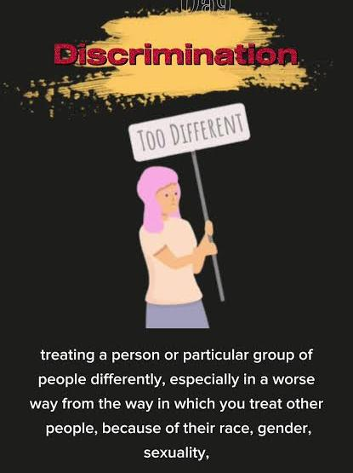
Article 1-Definition of Discrimination
Defines discrimination against women as any distinction, exclusion or restriction based on sex. Such discrimination may affect women's:
Human rights
Fundamental freedoms
Political, economic, social, cultural and civil rights.
Discrimination can occur directly or indirectly.

Slide 7
Article 2 – Elimination of Discrimination
States must:
Condemn discrimination against women.
Include the principle of equality of men and women in law and policy.
Adopt appropriate laws and other measures to prohibit discrimination.
Provide effective legal protection for women.
Ensure government authorities and institutions do not discriminate.
Modify or abolish discriminatory laws, customs and practices.

Slide 8
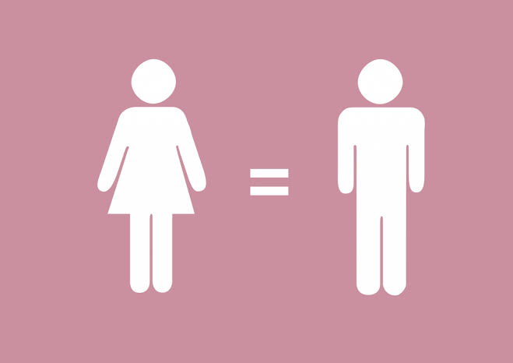
Article 3 — Development and Advancement of Women
States must take appropriate measures to ensure the full development and advancement of women, so that women can exercise and enjoy human rights and fundamental freedoms on an equal basis with men.

Slide 9
Article 4 — Temporary Special Measures
Allows temporary special measures, such as affirmative-action policies, to accelerate equality between women and men. Such measures are not considered discrimination and should end once equality of opportunity and treatment has been achieved.
It also permits special measures aimed at protecting maternity, provided they are not discriminatory.

Slide 10

Article 5 -Elimination of Gender Stereotypes
States must work to change:
Social and cultural patterns based on the idea that one sex is superior or inferior to the other.
Stereotyped roles for men and women.
States must also ensure that family education recognizes the common responsibility of men and women in raising and developing their children.

Slide 11
Article 6 - Suppression of Exploitation of Women
States must take appropriate measures, including legislation, to suppress trafficking in women and the exploitation of prostitution of women.

Slide 12
Article 7 — Political and Public Life
Women must have equal rights with men to:
Vote and stand for election.
Participate in government and public policy.
Hold public office and perform public functions.
Participate in non-governmental organizations and associations concerned with public and political life.

Slide 13
Article 8 — International Representation
States must ensure that women have the same opportunities as men to represent their governments internationally and participate in the work of international organizations.

Slide 14
Article 9 — Nationality
Women must have equal rights with men regarding nationality, including:
Acquiring, changing, or retaining nationality.
Passing their nationality to their children.
Marriage to a foreigner must not automatically change a woman's nationality or make her stateless.

Slide 15
Article 10 — Education
States must eliminate discrimination against women in education and provide equal opportunities in:
Admission to educational institutions.
Vocational and professional training.
Curricula and examinations.
Scholarships and financial assistance.
Continuing education and literacy programs.
Sports and physical education.
Access to educational information concerning health and family planning.
The article also emphasizes reducing female student drop-out rates and addressing educational inequalities.

Slide 16
Article 15 — Equality Before the Law
Women must have equality with men before the law.
States must ensure women have:
Equal legal capacity.
Equal rights to conclude contracts and administer property.
Equal treatment in courts and tribunals.
Freedom of movement.
Equal rights concerning residence and domicile.
Women must also have the same legal capacity as men, and agreements restricting that capacity are to be considered invalid

Slide 17
Article 16 — Marriage and Family Relations
States must eliminate discrimination against women in marriage and family relations.
Women and men must have equal rights regarding:
Entering into marriage.
Freely choosing a spouse.
Entering marriage only with free and full consent.
Rights and responsibilities during marriage and its dissolution.
Parenthood and decisions concerning children.

Slide 18
Article 16 — Marriage and Family Relations
Guardianship, custody, and adoption, subject to national law and the best interests of children.
Personal rights, including choosing a family name, profession, and occupation.
Ownership, management, administration, enjoyment, and disposition of property.
Child marriage is specifically addressed: the betrothal and marriage of a child should have no legal effect, and States should establish a minimum age for marriage and require registration of marriages.

Slide 19
Article 17 – Establishment of the CEDAW Committee
Establishes the Committee on the Elimination of Discrimination against Women.
The Committee consists of independent experts with expertise in women's rights.
It initially had 18 members, increasing to 23 members after the 35th State became a party.
Members are elected by States Parties but serve in their personal capacity, not as government representatives.

Slide 20
Article 18 – Reports by States
States Parties must submit reports to the Committee explaining the legal, administrative and other measures they have taken to implement CEDAW.
An initial report is required within one year of the Convention becoming applicable to that State, followed by periodic reports, generally every four years.

Slide 21
Article 19 – Rules of Procedures
The Committee adopts its own rules of procedure.
It elects its own officers and organizes its working methods.

Slide 22
Article 20 – Meetings
The Committee normally meets for the period necessary to carry out its functions.
Its meetings are organized with support from the United Nations.

Slide 23
Article 21 – Committee's Reports and Recommendations
The Committee reports annually to the UN General Assembly through the Economic and Social Council.
It can make suggestions and general recommendations based on information received from States Parties.

Slide 24
Article 22 – Specialized Agencies
UN specialized agencies may be invited to provide information about how CEDAW is being implemented in areas within their fields of work.
This helps the Committee assess women's rights issues using information from relevant international organizations.

Slide 25
Procedural Framework
An analysis of Part VI of the Convention on the Elimination of All Forms of Discrimination Against Women

Slide 26


Purpose & Scope of Part VI
Administrative Engine
Legal Integrity & Jurisdiction
Part VI (Articles 23 to 30) serves as the procedural bedrock of CEDAW. It governs how the treaty interacts with existing laws, how States formally commit, and how operational revisions occur over time
This final section regulates reservations to protect the treaty's core object and purpose, establishes dispute settlement mechanisms via negotiation or ICJ arbitration, and defines official authentic texts.

Slide 27
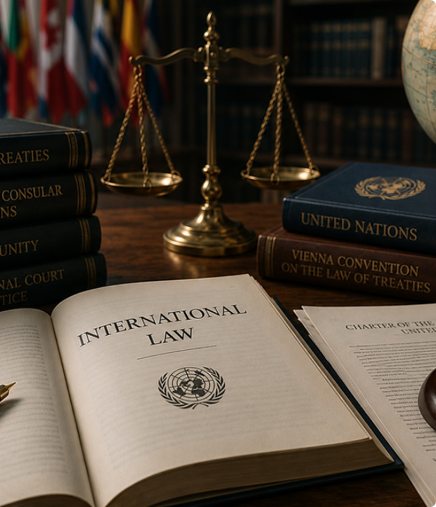
Articles 23 & 24 Framework
Article 23: Non-Derogation Standard
Ensures that nothing in CEDAW shall affect provisions that are more conducive to the achievement of equality between women and men contained in national legislation or other international treaties.
Article 24: Duty to Implement
Requires States Parties to adopt all necessary measures at the national level aimed at achieving the full realization of rights recognized in the Convention.

Slide 28






Articles 25, 26 & 27 Overview
Article 25: Adoption
Article 26: Revision
Article 27: Entry into Force
Opens the treaty for signature, ratification, and accession by all States. Instruments are formally deposited with the Secretary-General of the United Nations.
Allows any State Party to request a revision of the Convention at any time by submitting a written notification to the UN Secretary-General.
Establishes that CEDAW enters into force on the 30th day after the deposit of the 20th instrument of ratification or accession (achieved Sept 3, 1981).

Slide 29

Article 28: Treaty Reservations
Rules & Compatibility Test
Article 28 regulates how member states can lodge reservations upon signing, ratifying, or acceding to the treaty:
• Incompatibility Test: A reservation incompatible with the object and purpose of CEDAW is strictly impermissible.
• Depositary Role: The UN Secretary-General receives and circulates reservation texts to all States.
• Withdrawal: Reservations may be withdrawn at any time by official notification.

Slide 30

Article 29: Dispute Settlement
Escalation & ICJ Jurisdiction
Tier 1 — Negotiation & Arbitration: Any dispute between two or more States Parties concerning interpretation or application not settled by negotiation shall be submitted to arbitration at the request of one of them.
2
Tier 2 — International Court of Justice: If arbitration is not organized within 6 months, any party may refer the dispute to the ICJ. States may declare an opt-out reservation to this clause.
Formal Resolution Tiers

Slide 31



Pillars of CEDAW Governance
UN Depositary
Judicial Adjudication
National Realization
Articles 25 & 27 establish the UN Secretary-General as the central legal custodian for all state instruments.
Article 29 anchors state accountability through formal arbitration and International Court of Justice oversight.
Article 24 obligates governments to continuously adapt domestic institutions to empower women universally.

Slide 32
Optional Protocol to CEDAW was adopted by the UN General Assembly in 1999
It strengthens the implementation of CEDAW by providing two important procedures.
First, the Individual Communications Procedure allows women or groups to submit complaints to the CEDAW Committee regarding violations of their rights.
Second, the Inquiry Procedure enables the Committee to investigate grave or systematic violations of women’s rights. The Protocol enhances accountability, provides avenues for remedies, and strengthens international protection against discrimination and violations of women’s human rights.

Slide 33
Major Indian Enactments Influenced by CEDAW
Sexual Harassment of Women at Workplace (POSH) Act, 2013: Originates from the Supreme Court's ruling in Vishaka v. State of Rajasthan (1997), where the court explicitly drew from CEDAW Articles 11 (Employment) and 24 (Implementation) to formulate binding guidelines in the absence of enacted statutory law.
Protection of Women from Domestic Violence Act, 2005: Drafted to align with CEDAW General Recommendation No. 19 (Gender-based violence). It expanded legal remedies beyond traditional penal provisions to cover physical, sexual, emotional, and economic abuse within domestic relationships.
Maternity Benefit (Amendment) Act, 2017: Implements obligations under CEDAW Article 11(2) by increasing paid maternity leave to 26 weeks, mandating creche facilities, and protecting working mothers against discrimination or termination due to pregnancy.

Slide 34
Major Indian Enactments Influenced by CEDAW
Criminal Law (Amendment) Act, 2013: Enacted based on recommendations from the Justice Verma Committee, which relied on CEDAW standards to broaden definitions of sexual assault, consent, and state accountability for gender-based violence.
Prohibition of Child Marriage Act, 2006: Operationalizes CEDAW Article 16(2), which invalidates child marriages and mandates state action to specify a legal minimum age for marriage and registration.

Slide 35
Key Indian Judicial Precedents Applying CEDAW to Domestic Law
Vishaka v. State of Rajasthan (1997): Established that international conventions like CEDAW can be read into fundamental rights under Article 21 (Right to Life) and Article 19 (Freedom of Profession) in the absence of explicit municipal laws.
Githa Hariharan v. Reserve Bank of India (1999): Applied CEDAW Article 5(b) to interpret Section 6(a) of the Hindu Minority and Guardianship Act, ruling that a mother has equal natural guardianship rights alongside the father.
Rupan Deol Bajaj v. K.P.S. Gill (1995): Leveraged CEDAW obligations to enforce protections against outrage to modesty and workplace misconduct.

Slide 36
thankyou

